Slide 1
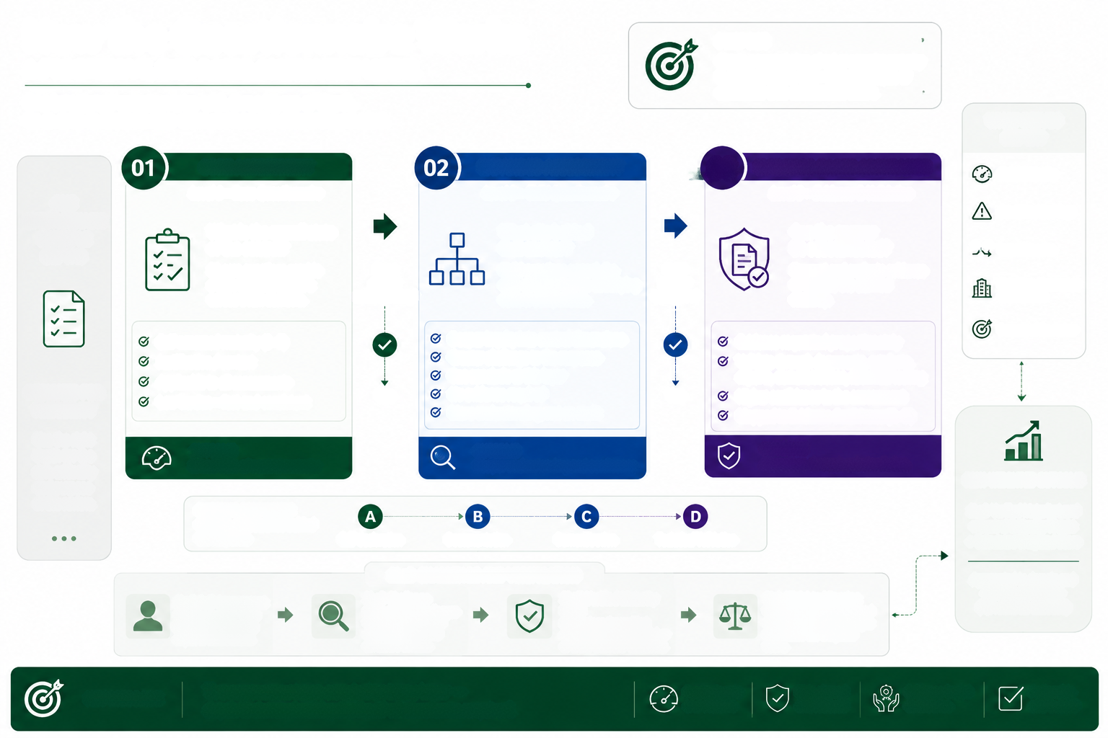
How the Questionnaire Works
A PROGRESSIVE, RISK-BASED ASSESSMENT MODEL
PURPOSE
Obtain a trusted view of cyber security maturity
in a proportionate way-balancing depth of
assurance with assessment effort.
One integrated questionnaire with three layers of depth.
Go as deep as required. Stop when you have the assurance you need.
WHAT DRIVES
DEPTH?
CORE ASSESSMENT
EXPANDED ASSESSMENT
03
EVIDENCE-BASED ASSURANCE
Risk/Criticality
ONE
Level 1 - Base Questionnaire
Level 2 - Child Questionnaire
Level 3 - Evidence & Validation
QUESTIONNAIRE
X A
Concerns/Red flags
MULTIPLE
What is the overall state
of the control?
What sits behind
that answer?
Can the answer
be substantiated?
Request and evaluate evidence
to validate the claimed
maturity.
DEPTHS
Inconsistencies
31 core questions provide
Need
greater
understanding?
Child questions unpack the
core question into its underlying
control components.
Need
a high-level assessment
across 8 risk domains.
greater
assurance?
Regulatory/Contractual
requirements
Self-assessed maturity (0-5)
Deeper inquiry into control dimensions
Greater challenge to the response
Evidence requested proportionately
Validate through documents, artefacts,
reports, demonstrations, technical testing
Higher confidence in the assessment
Mapped to Evidence Confidence (A-D)
Purpose of the review
Justification / context
Can conclude at this layer
DESIGNED FOR
FLEXIBILITY
Applicable to all assessments
Yes
No evidence required
Yes
Low burden - fast and consistent
More understanding, not an audit
Use the right
OUTCOME
OUTCOME
OUTCOME
depth for the
Broad view of control maturity
Deeper understanding and confidence
Assurance through substantiation
risk, criticality
RISK-WEIGHTED OUTCOME
and purpose
of the review.
EVIDENCE CONFIDENCE
Strength of assurance behind
the response
2LOD Verified Maturity Level
x Control Criticality Weight
= Calculated Weighted Score
Self-declaration
Documentation
Demonstration
Technical Validation
2LOD CHALLENGE AND VERIFICATION
Aggregated to domain and
overall maturity view
(N/A controls excluded)
1LoD Self-Assessment
Provides maturity level
based on the selected
depth of assessment.
2LoD Challenge
2LOD Verified Maturity
Level
Determines the verified
maturity level (may be higher
or lower than self-assessed).
Risk-Weighted Scoring
Verified maturity is combined
with control criticality weight
to produce the weighted
score.
Independently challenges
the response, reviews
evidence (if any) and
considers context.
KEY MESSAGE
The assessment can conclude at any layer -
depth is determined by the level of assurance required.
Proportionate
Risk-aligned
and focused
Evidence-based
confidence
Actionable
and trusted
and scalable

